Slide 1

Empowering your workforce to make smarter security decisions, every day
Nathan Mayer
VP UKI

Slide 2
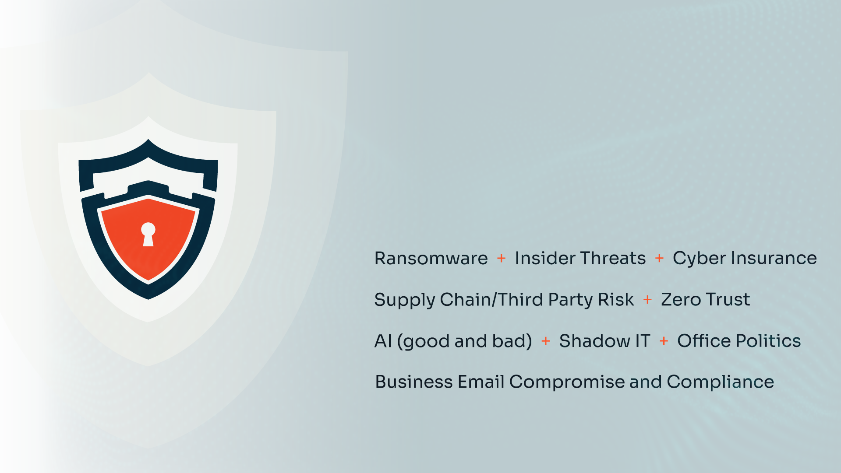
You Face Unprecedented Security Challenges Every Day

Slide 3
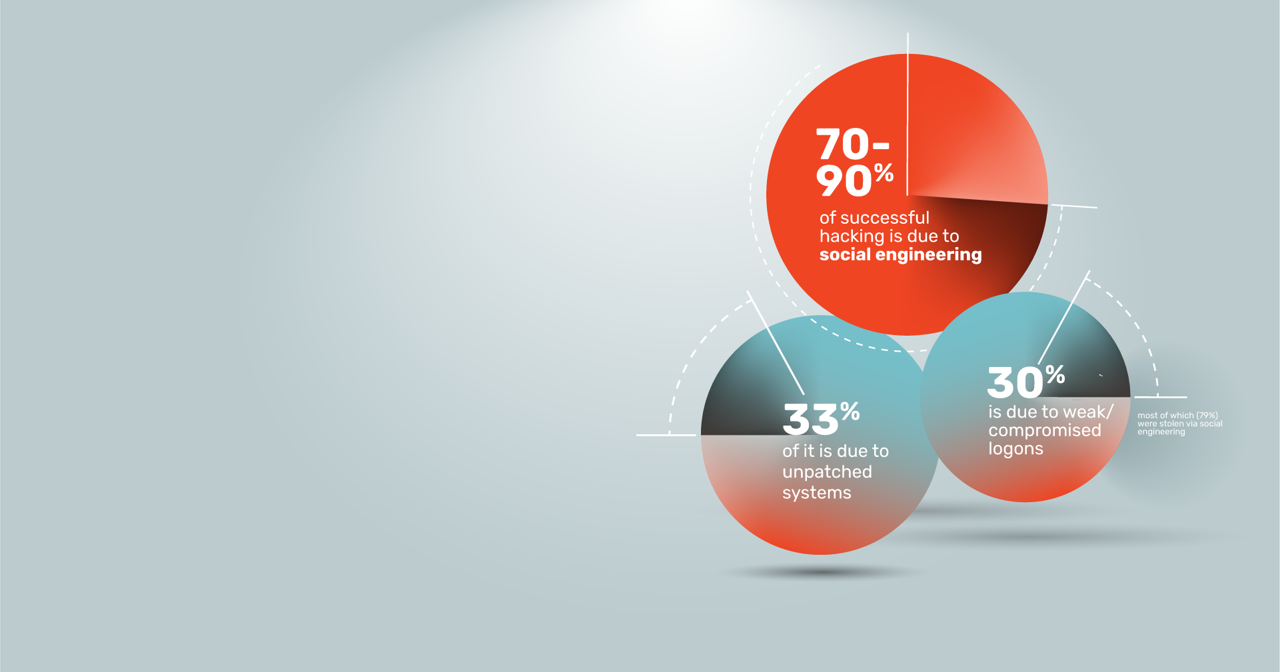
Did you know that only three things account for 99% of the cybersecurity challenges?
These three issues are absolutely 99% of
your problem. How much of your day is
spent focusing on resolving these three problems vs. everything else?

Slide 4


People are a critical layer within the fabric of your security programs

Slide 5
Strengthening Your Security Culture

Slide 6
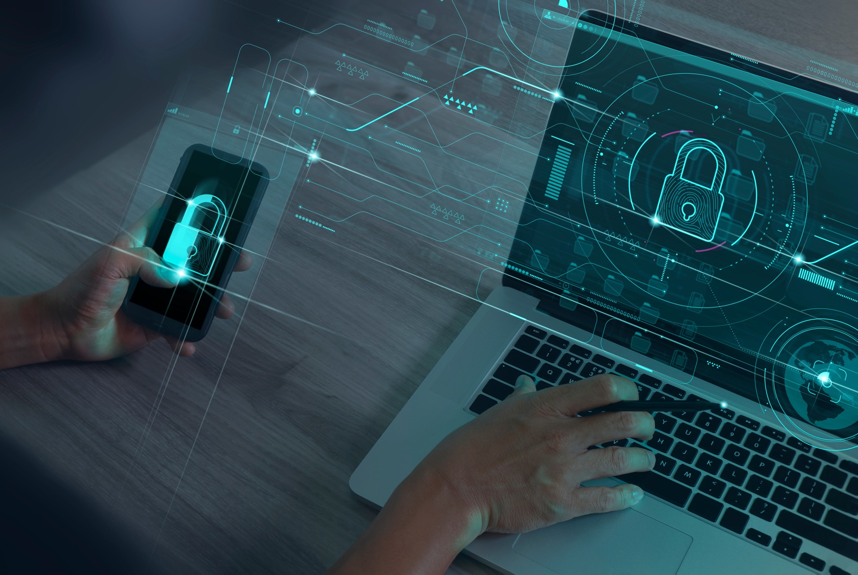
How Can You Protect Your Organization?
Users are unaware of the internet dangers and get tricked by social engineering to click on a malicious link in a (spear) phishing email or opening an email attachment they did not ask for.
Employees have a false sense of security and believe their antivirus has them covered. With the firehose of spam and malicious email that attack your network, approximately 20% of phishing emails bypass Microsoft 365 and SEGs*
Backups don't always work, or it takes days to restore a system.
Today, an essential, additional security layer is to have your workforce be your last line of defense.
* KnowBe4 Egress 2024 Phishing Threat Trends Report

Slide 7
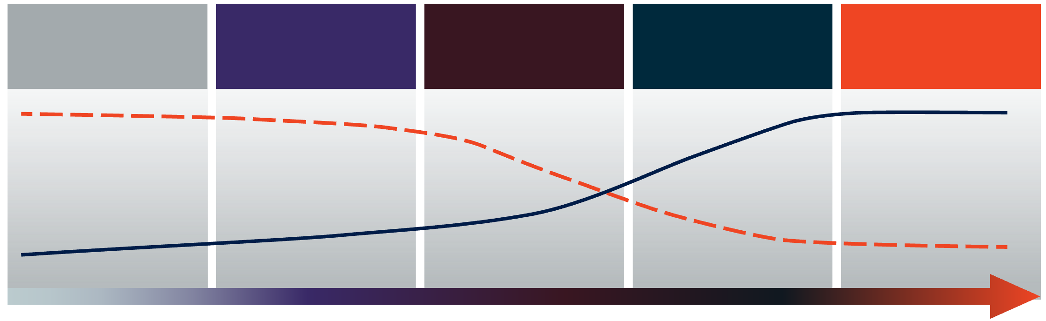

Develop A Strong Security Culture To Reduce Risk
A strong security culture means more secure employee behaviors and reduced organizational risk.
As security awareness, behavior and culture increases, the likelihood of human-related breach and cost of remediation decreases.
LEVEL 1
LEVEL 2
LEVEL 3
LEVEL 4
LEVEL 5
Security Awareness Foundation
Programmatic Security Awareness & Behavior
Security Behavior Management
Sustainable Security Culture
Basic Compliance
The dashed red line represents breach likelihood and relative cost remediation
Source: KnowBe4
The solid blue line represents awareness/culture maturity gains at each stage of the model

Slide 8



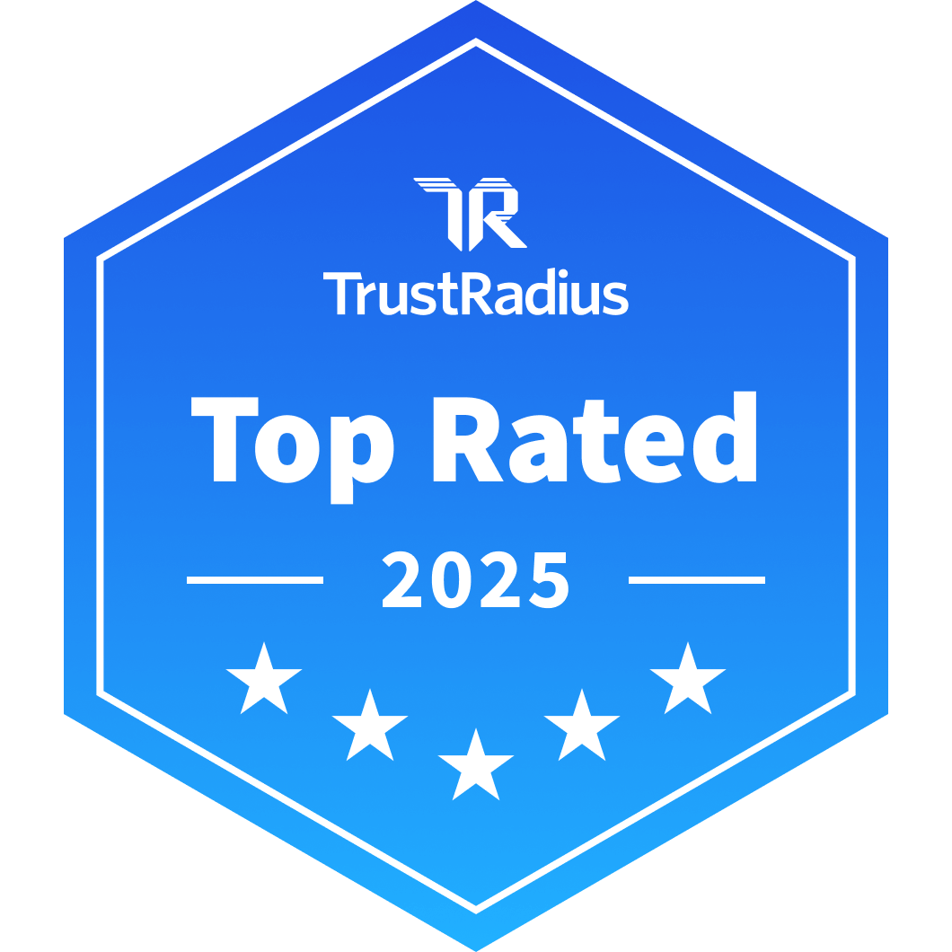
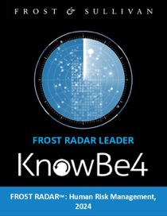
We help ~70,000 organizations build a strong security culture to manage the ongoing problem of social engineering and human risk
Global Sales,
Courseware Development, Customer Success, and Technical Support teams worldwide
About KnowBe4
Magic Quadrant Leader
Trusted by 47 of the world’s top 50 cybersecurity companies, and the largest human risk management platform
CEO & employees are industry veterans in cybersecurity
Offices in the USA, UK, Canada, France, Netherlands, India, Germany, South Africa, United Arab Emirates, Singapore, Japan, Australia, and Brazil

Slide 9
HRM+ Platform –
AI-Driven ‘Best in Suite’ Platform for Human Risk Management

Slide 10

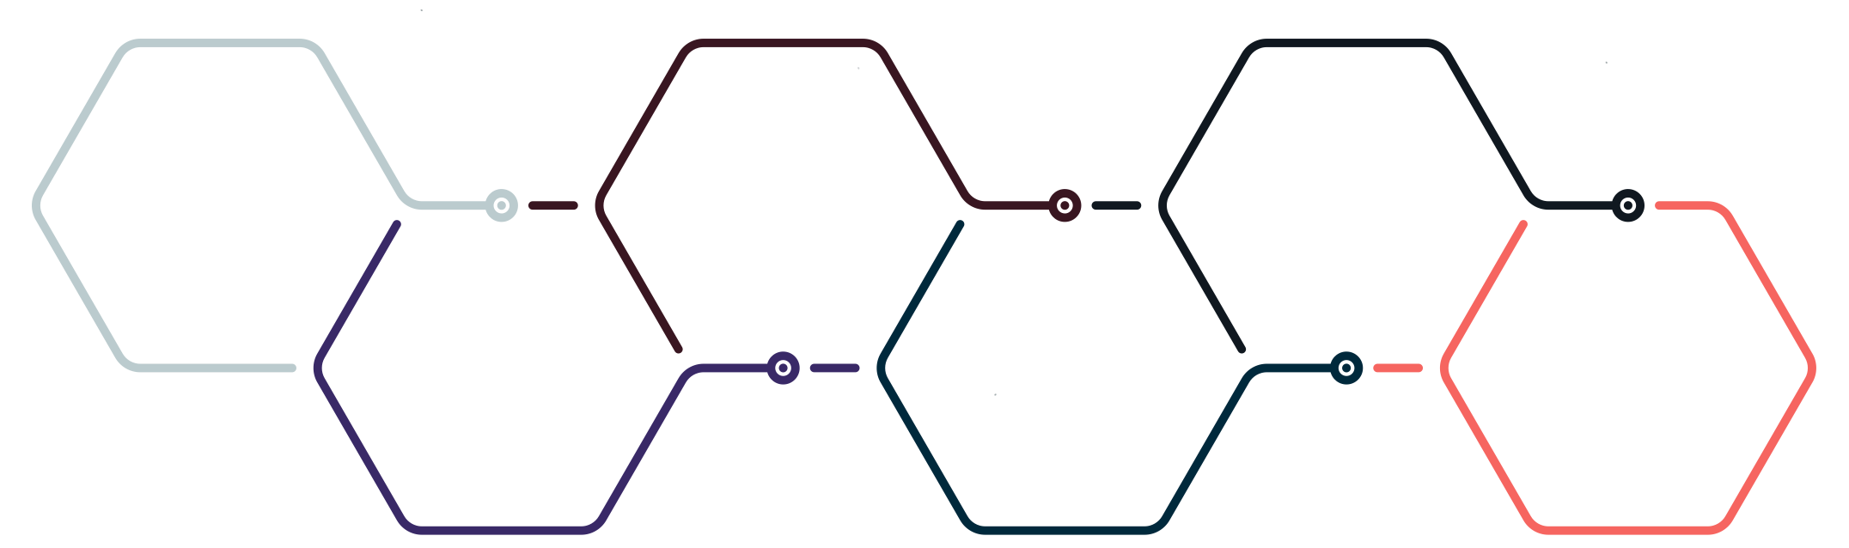
One Platform for Human Risk Management
The HRM+ platform includes modules for awareness and compliance training, cloud email security, real-time security coaching, crowdsourced anti-phishing, AI Defense Agents and more. As the only global security platform of its kind, KnowBe4 transforms your largest attack surface—your workforce—into your biggest asset, actively protecting your organization against cybersecurity threats.
Security
Awareness
Training
+
Anti-
Phishing
+
Compliance
Training
+
Cloud
Email
Security
+
Real-Time
Coaching
+
AI Defense
Agents
=
HRM+ Personalized. Relevant. Adaptive.

Slide 11
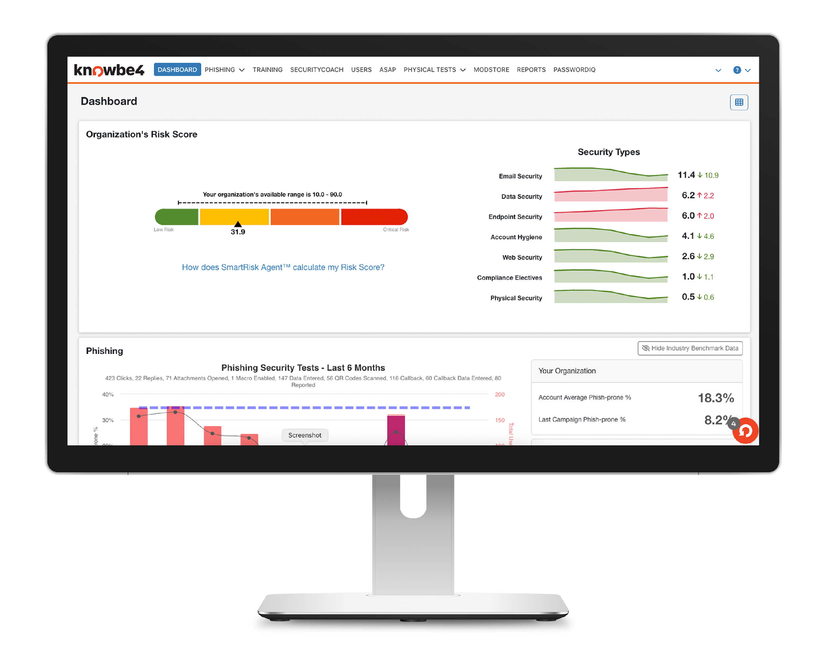
Security Awareness Training
AI-powered, new-school security awareness training and simulated phishing that allows organizations to drive awareness and change user behavior. Build a stronger security culture by effectively managing the ongoing problem of social engineering.

Slide 12
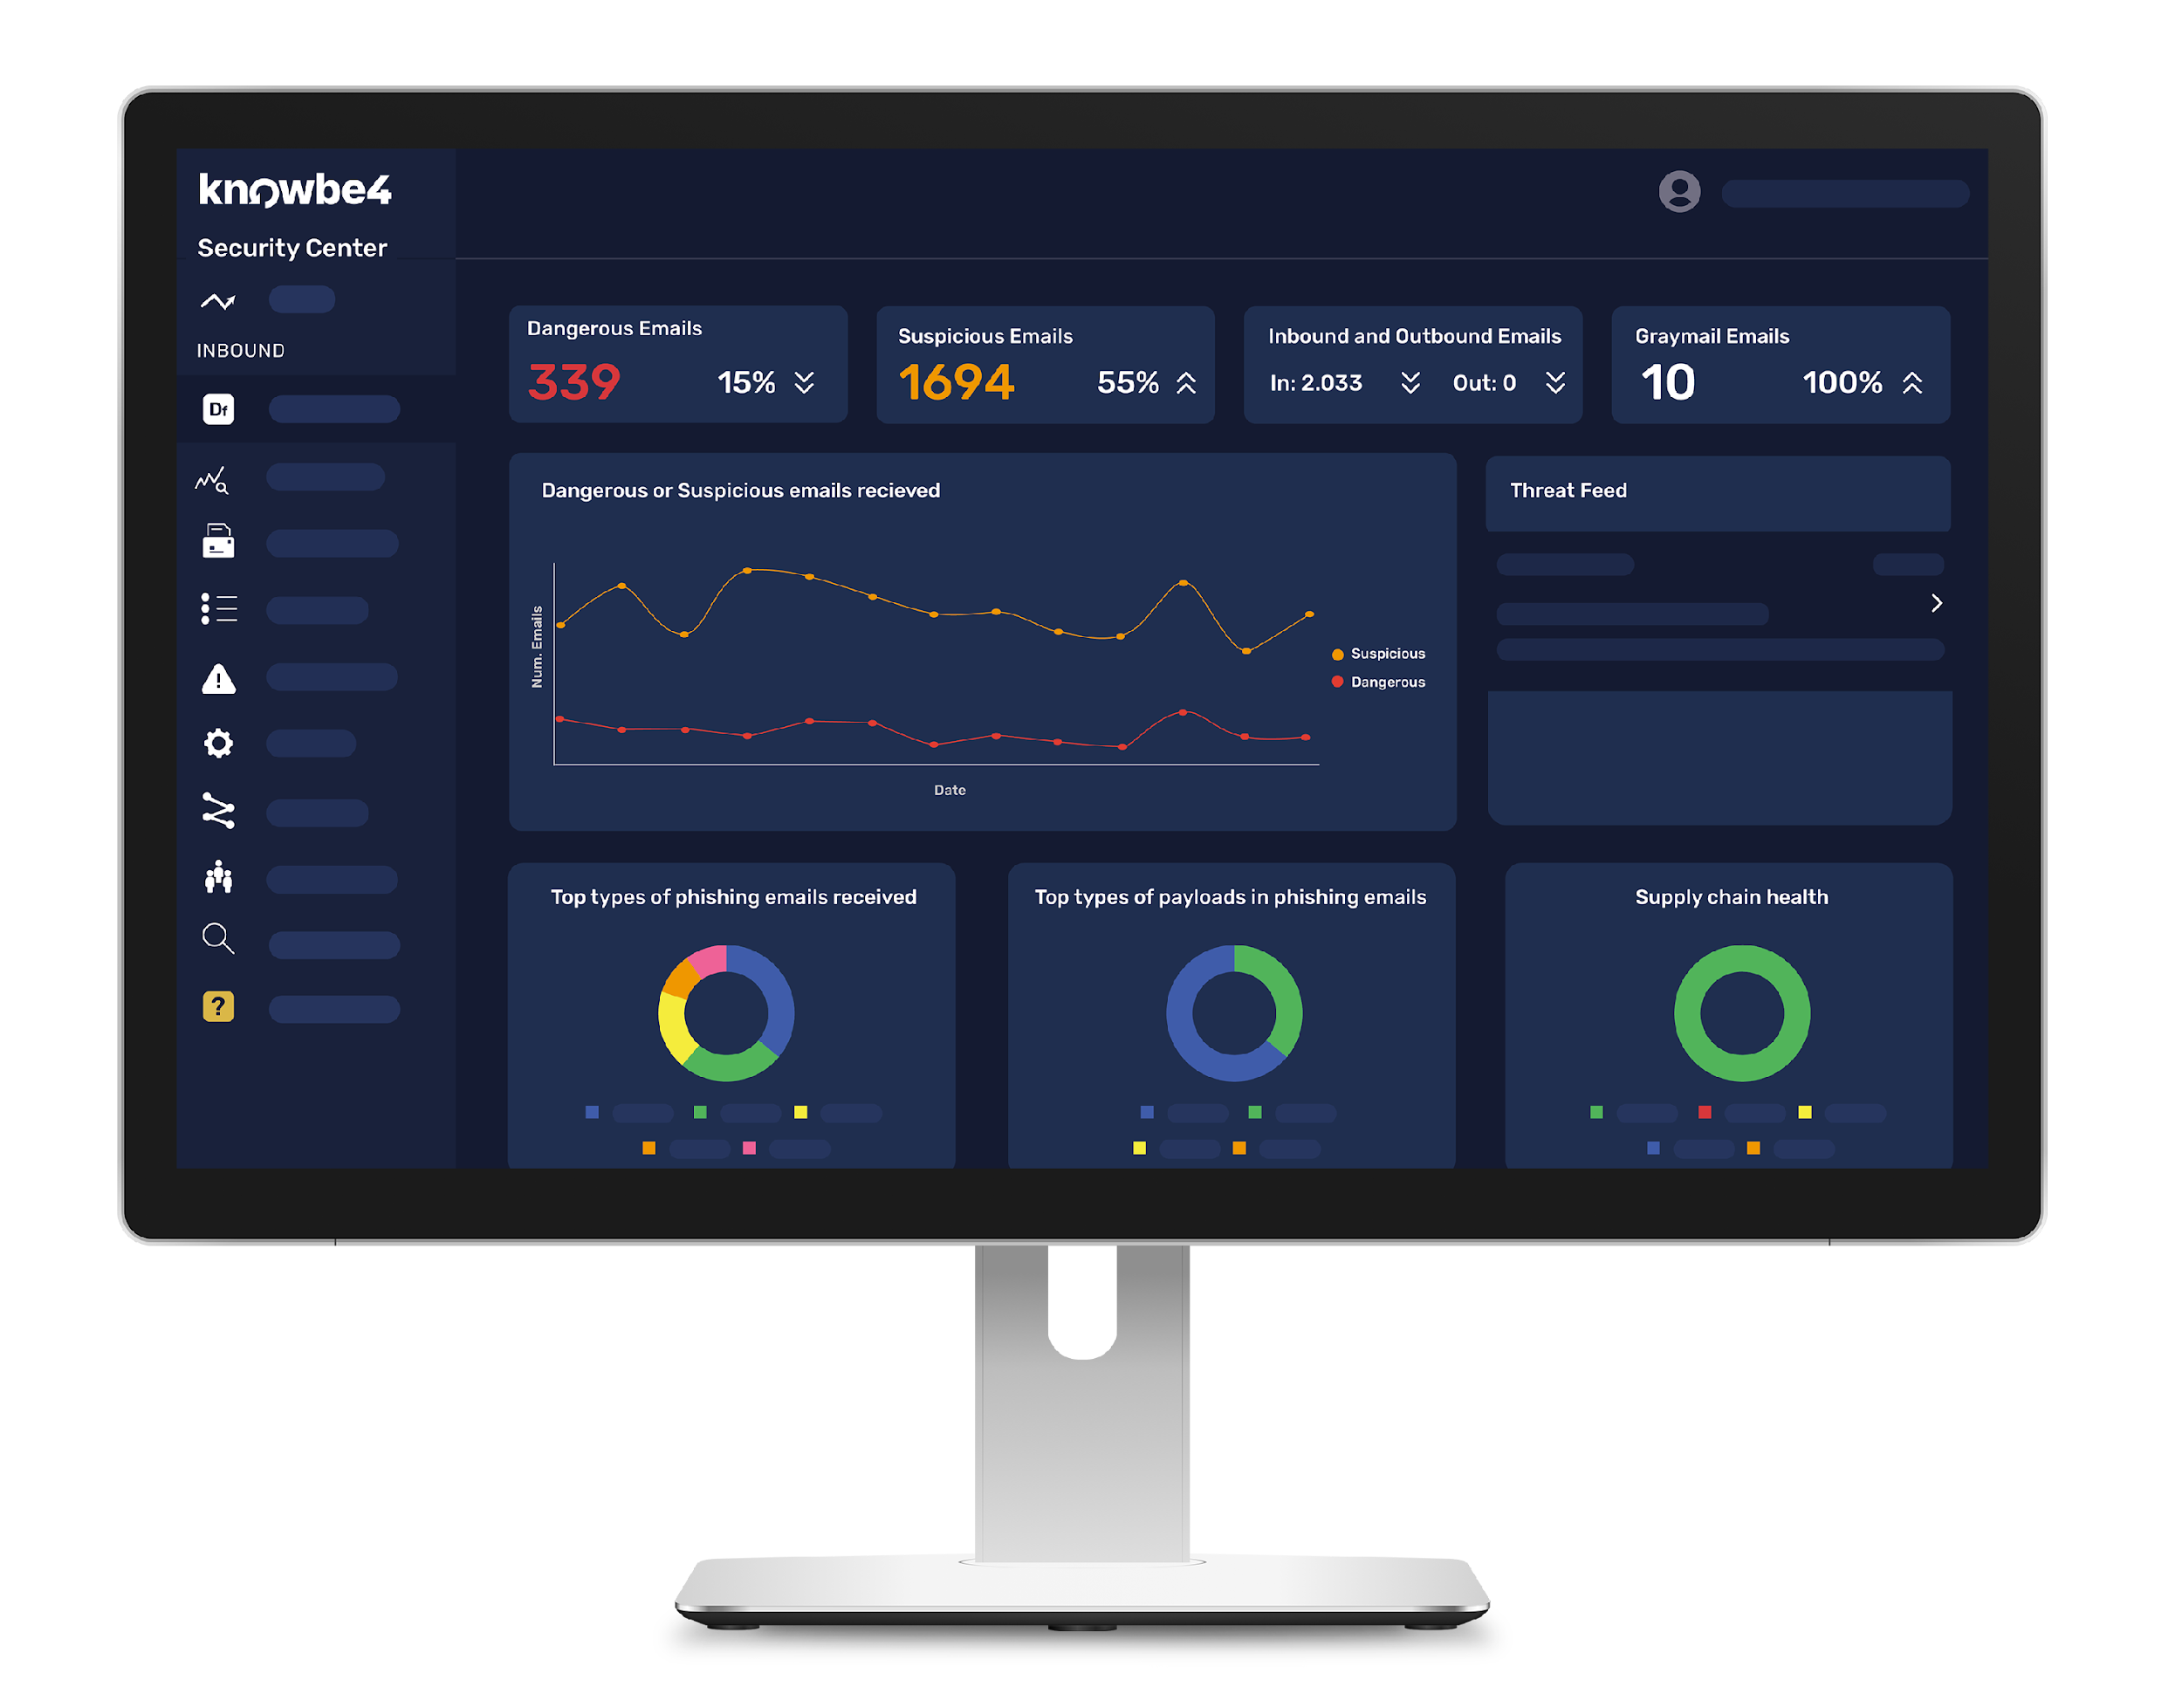
Cloud Email Security
The only end-to-end inbound and outbound email security platform to continually assess human risk and dynamically adapt security controls, preparing customers to defend against advanced phishing threats, human error, and data exfiltration.
Directly integrates with Microsoft Defender for Office 365 as one of only two partners within Microsoft’s new ICES vendor ecosystem.

Slide 13
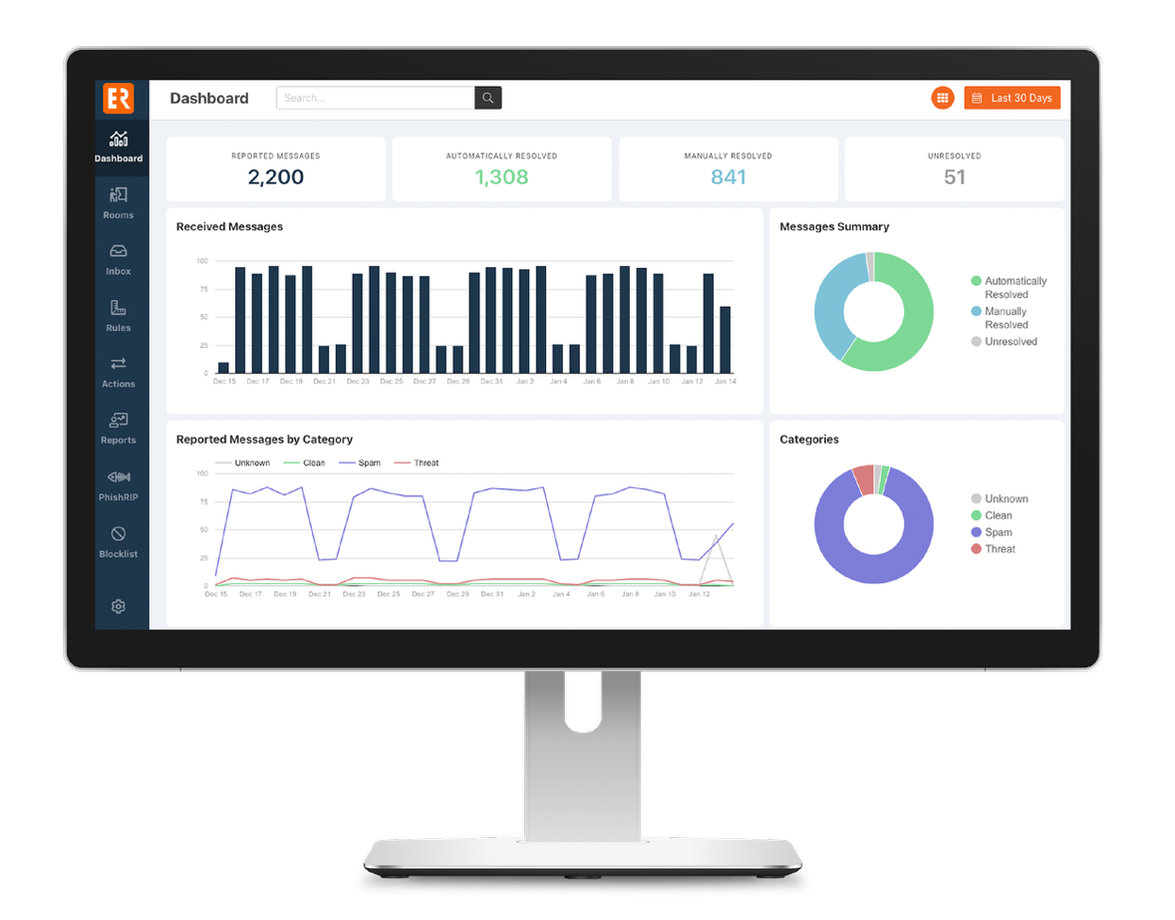
PhishER Plus
Security orchestration and proactive anti-phishing protection to allow your incident response and security orchestration teams to identify and stop phishing threats before they reach your users' inboxes.

Slide 14
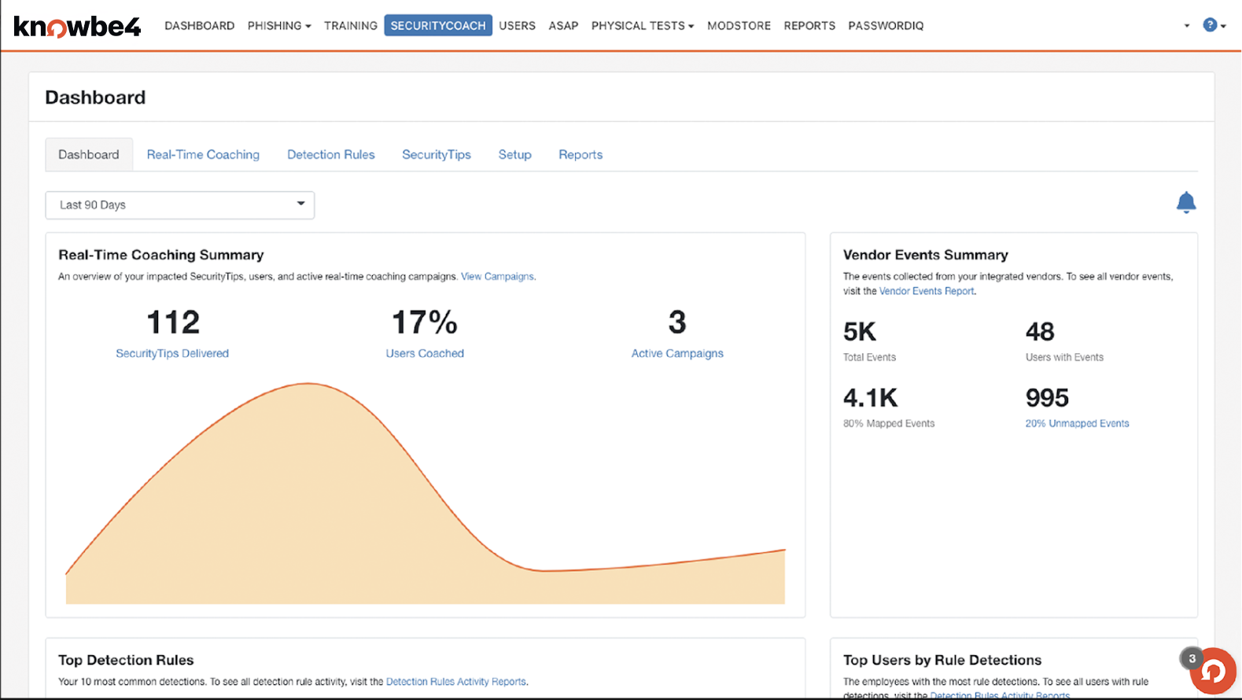
SecurityCoach
The first ever real-time security coaching product that detects and responds to risky end user behavior to provide immediate feedback, improving overall security culture and reducing human risk.

Slide 15
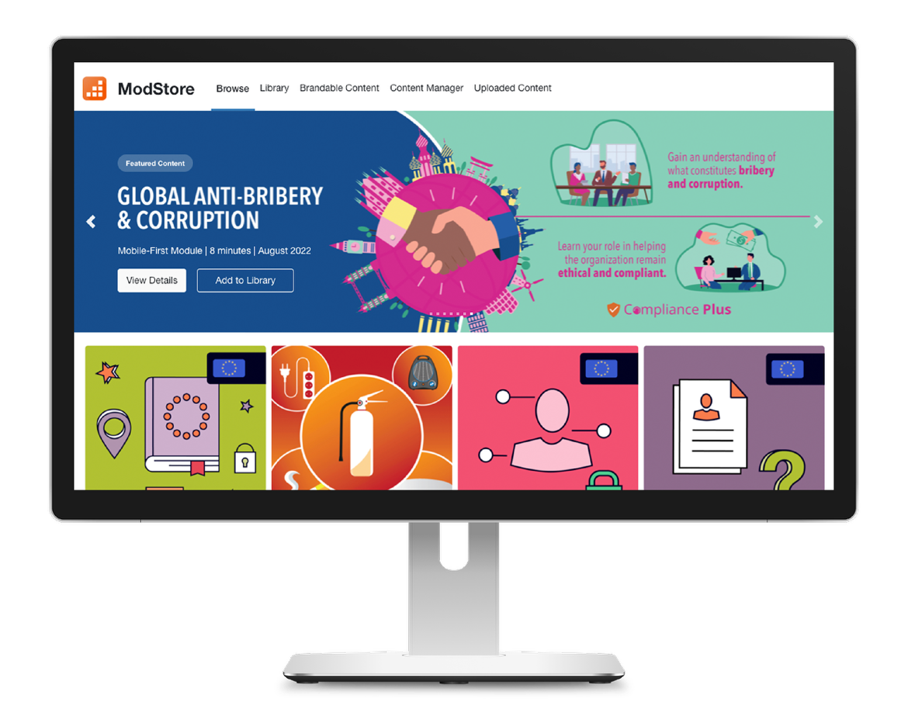
Compliance Plus
New-school compliance training that delivers continuously updated, engaging, customizable content to users and allows your organization to take a comprehensive approach to security awareness and compliance training.

Slide 16
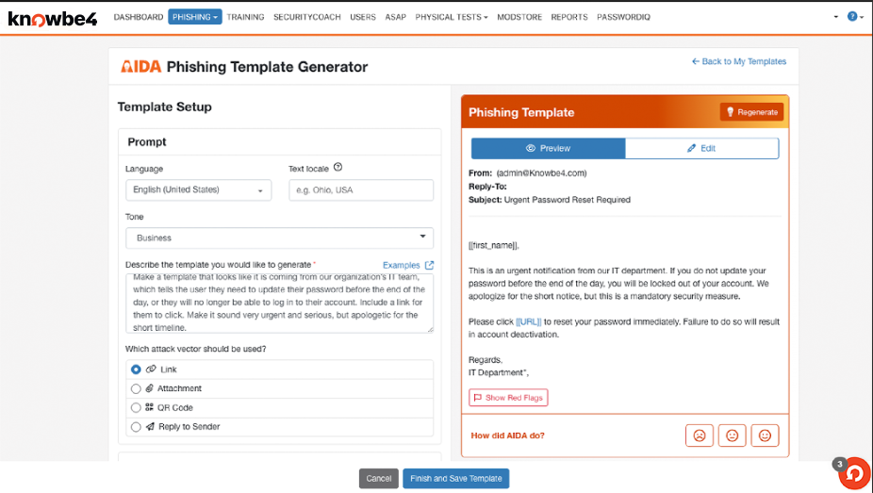
AIDA
An advanced suite of AI-powered agents that elevates your human risk management strategy.

Slide 17

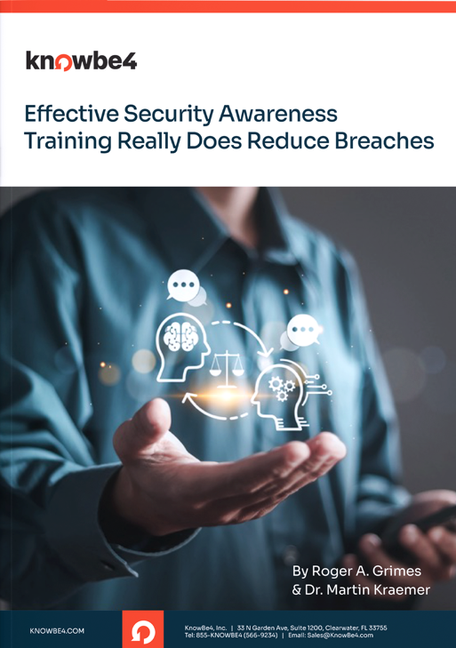
Effective SAT Really DOES Reduce Data Breaches
97.6%
65%
8.3x
of KnowBe4 U.S. customers
had no public data
breaches since 2005.
Breached customers were
65% less likely to suffer additional breaches while being KnowBe4 customers.
Organizations were 8.3 times less likely to appear on breach lists after implementing KnowBe4 SAT.
*Study based on analyzing 35,000 separate breach notification data in the Privacy Rights Clearinghouse and KnowBe4 customers

Slide 18
Prove ROI to Your CEO and Board
“It would take at least 2 FTEs to create the security awareness training content, make it engaging, translate it, deliver it to all users, track their progress, and send simulated phishing emails. Now, we don’t have to worry about any of this. We spend a few hours at the beginning of the year and we’re done.”
- Cybersecurity Infrastructure Engineer
“The reduction in our Phish-prone Percentage is directly related to the reduction in risk from a data breach or ransomware attack.”
- Security Analyst
“We had competing bids for cyber-insurance. Many of the bids were from companies that in the past refused to cover us but now, because we are working with KnowBe4, our premiums have gone down.”
- Security Analyst
Money Saved
£537,173
in time earnings delivering security awareness training, compliance training and phishing simulations
£952,673
in savings from improving SAT operations and strengthening risk prevention
£415,500
reduction in risk exposure over three years
257% ROI
3.5 months payback period with a three-year ROI
*2,000 seat customer
Notes:
Schedule a customer ROI analysis.

Slide 19
THANK YOU!

